Slide 1
Chapter 13 I/O Systems

Slide 2
教学内容、目标与要求
教学内容
I/O系统概述
I/O硬件
应用I/O接口
内核I/O子系统
I/O请求转换为硬件操作
教学重点
2、4
教学目标与要求
了解并掌握操作系统I/0子系统结构；
了解并掌握I/O硬件原理。
2

Slide 3
Contents
13.1 Overview
13.2 I/O Hardware
13.3 Application I/O Interface
13.4 Kernel I/O Subsystem
13.5 Transforming I/O Requests to Hardware Operations
13.6 Streams(*)
13.7 Performance(*)
3

Slide 4
13.1 Overview
I/O management is a major component of operating system design and operation.
Important aspect of computer operation
I/O devices vary greatly
Various methods to control them
Performance management
New types of devices frequent
Two trends
Increasing standardization of software and hardware interfaces.
Increasingly broad variety of I/O devices.
标准化，统一接口
USB（Universal Serial Bus）
多样化，统一接口
方便用户、制造商
4

Slide 5
Overview
The basic I/O hardware elements accommodate a wide variety of I/O devices.
Ports, busses, device controllers connect to various devices.
To encapsulate the details and oddities of different devices, the kernel is structured to use device-driver modules.
The device drivers present a uniform device access interface to the I/O subsystem.
much as system calls provide a standard interface between the application and the operating system.
I/O接口，
安全访问，资源保护
5

Slide 6
13.2 I/O Hardware
Incredible variety of I/O devices, the general categories:
Storage (disks, tapes)
Transmission (network connections, Bluetooth)
Human-interface (screen, keyboard, mouse, audio in and out, camera)
Common concepts-- signals from I/O devices interface with computer.
Port : connection point for device, e.g. serial port.
Bus: a set of wires and a rigidly defined protocol that specifies a set of messages that can be sent on the wires (daisy chain or shared direct access).
PCI bus, common in PCs and servers, PCI Express (PCIe)
expansion bus connects relatively slow devices.
Controller (host adapter): a collection of electronics that can operate a port, a bus, or a device.
Sometimes integrated, Serial-port controller
Sometimes separate circuit board, SCSI bus controller
Contains processor, microcode, private memory, etc.
Built-in controller, hard disk controller
Microcode, processor,
Bad block processing, prefetching, buffering, catching, etc.
6

Slide 7
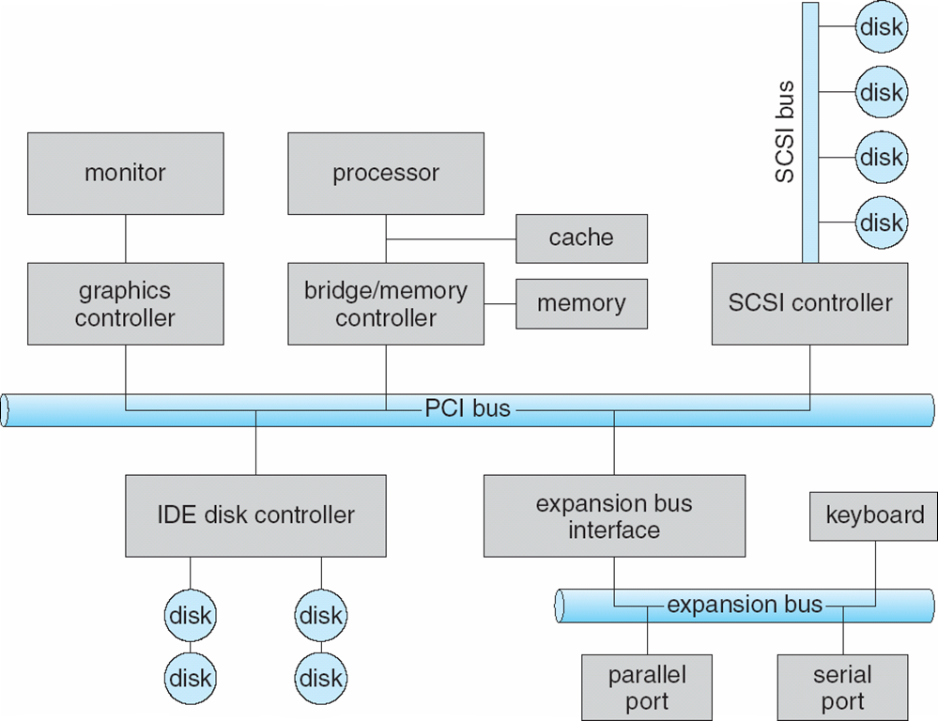
A Typical PC Bus Structure
7

Slide 8
I/O Hardware
Processor give commands and data to a controller to accomplish an I/O transfer.
I/O instructions control devices.
Controller usually have registers, where device driver places commands, addresses, and data to write, or read data from registers after command execution.
Data-in register, data-out register, status register, control register
Devices have addresses, used by
Direct I/O instructions
Memory-mapped I/O
Device data and command registers mapped to processor address space
Especially for large address spaces (graphics controller)
8

Slide 9
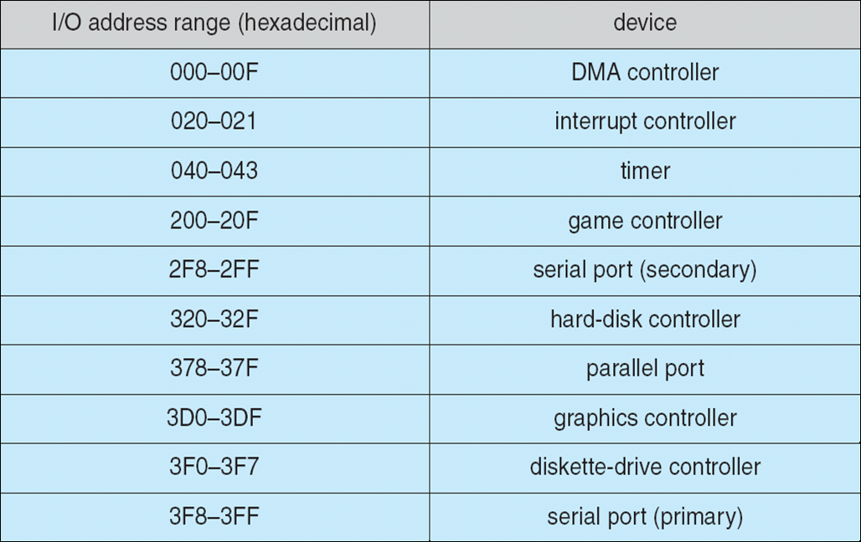
Device I/O Port Locations on PCs (partial)
9

Slide 10
I/O port
4 registers
Status: contains bits that can be read by the host. Idle, busy, ready, error
Control: can be written by the host to start a command or to change the mode of a device.
Data-in: read by the host to get input.
Data-out: written by the host to send output.
Data registers are typically 1 to 4 bytes in size.
Some controllers have FIFO chips to expand the capacity of the controller beyond the size of the data register.
FIFO chips can hold several bytes of input or output data.
10

Slide 11
Techniques for Performing I/O
Programmed I/O / polling
Process is busy-waiting for the operation to complete
Interrupt-driven I/O
I/O command is issued
Processor continues executing instructions
I/O module sends an interrupt when done
Direct Memory Access (DMA)
DMA module controls exchange of data between main memory and the I/O device
Processor interrupted only after entire block has been transferred
11

Slide 12
Polling
busy-wait cycle to wait for I/O from device.
Reasonable if device is fast, but inefficient if device slow.
CPU switches to other tasks?
Determines state of device
command-ready, busy, Error
Handshaking （host and controller, e.g. write out a byte）
host repeatedly reads the busy bit until that bit becomes clear.
host sets the write bit, and writes a byte into data-out register.
host sets the command-ready bit.
When the controller notices that the command-ready bit is set, it sets the busy bit.
controller reads the command register and sees the write command. It reads the data-out register to get the byte, and does the I/O to the device.
controller clears the command-ready bit, clears error bit in the status register, and clears the busy bit.
Polling can happen in 3 instruction cycles
read status, logical-and to extract status bit, branch if not zero
How to be more efficient if non-zero infrequently?
12

Slide 13
Thinking the following question
The example of handshaking in polling used 2 bits: a busy bit and a command-ready bit.
Is it possible to implement this handshaking with only 1 bit? If it is, describe the protocol. If it is not, explain why 1 bit is insufficient.
13

Slide 14
Answer:
It is possible, using the following algorithm. Let’s assume we simply use the busy-bit (or the command-ready bit; this answer is the same regardless).
When the bit is off, the controller is idle.
The host writes to data-out and sets the bit to signal that an operation is ready (the equivalent of setting the command-ready bit).
When the controller is finished, it clears the busy bit. The host then initiates the next operation.
This solution requires that both the host and the controller have read and write access to the same bit, which can complicate circuitry and increase the cost of the controller.
14

Slide 15
Interrupts
CPU Interrupt-request line triggered by I/O device
Controller asserting a signal on the interrupt request line.
Checked by processor after each instruction
Interrupt handler receives interrupts
Maskable to ignore or delay some interrupts
Interrupt vector to dispatch interrupt to correct handler
Context switch at start and end
Based on priority
Some nonmaskable
Interrupt chaining if more than one device at same interrupt number.
15

Slide 16
Interrupt-Driven I/O Cycle
CPU
1
I/O controller
2
device driver initiates I/O
initiates I/O
CPU executing checks for
interrupts between instructions
3
7
CPU receiving interrupt,
transfer control to
Interrupt handler
4
input ready,
output complete, or error
Generates interrupt signal
5
Interrupt handler processes
data, returns from interrupt
6
CPU resume processing
of interrupted task
16

Slide 17
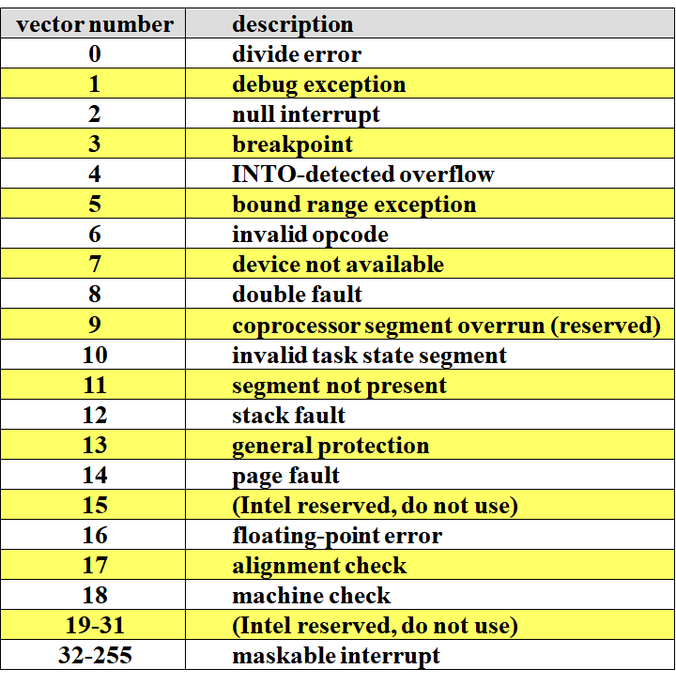
Interrupts
Two interrupts request lines
Nonmaskable, reserved for critical events.
Maskable, turned off to ignore or delay some interrupts.
Intel Pentium Processor Event-Vector Table:
Interrupt priority levels
enable the CPU to defer the handling of low-priority interrupts without masking all interrupts.
makes it possible for a high priority interrupt to preempt the execution of a low-priority interrupt.
17

Slide 18
Interrupts
Interrupt mechanism also used for exceptions:
Dividing by zero
accessing a protected or nonexistent memory address
Attempting to execute a privileged instruction from user mode
Good uses:
System call
Page fault
Used for time-sensitive processing, frequent, must be fast.
18

Slide 19
Direct Memory Access
Used to avoid programmed I/O (PIO) for large data movement.
Requires DMA controller, a special-purpose processor.
Bypasses CPU to transfer data directly between I/O device and memory.
Host writes a DMA command block into memory.
Source and destination addresses
Read or write mode
Count of bytes
CPU writes the address of this command block to the DMA controller.
DMA controller operates the memory bus directly, placing address on the bus to perform transfers.
When the entire transfer is finished, the DMA controller interrupts the CPU.
19

Slide 20
Direct Memory Access
Handshaking between the DMA controller and the device controller:
performed via a pair of wires called DMA-request and DMA-acknowledge.
The device controller places a signal on the DMA-request wire when a word of data is available for transfer.
This signal causes the DMA controller to
seize the memory bus
place the desired address on the memory-address wires
place a signal on the DMA-acknowledge wire.
When the device controller receives the DMA-acknowledge signal, it transfers the word of data to memory and removes the DMA-request signal.
20

Slide 21
Six Step Process to Perform DMA Transfer
PCI bus
1. device driver is told to transfer
disk data to buffer at address X
5. DMA controller transfers bytes to buffer X, increasing memory address and decreasing C until C=0
2. device driver tells disk controller to transfer C bytes from disk to buffer at address X
CPU
cache
CPU memory bus
DMA/bus/interrupt
controller
X
6. when C=0, DMA interrupts CPU
to signal transfer completion.
memory
buffer
IDE disk controller
3. disk controller initiates DMA transfer
disk
disk
4. disk controller sends each byte to DMA controller
disk
disk
21

Slide 22
Direct Memory Access
DMA controller seizes the memory bus, Cycle stealing is used to transfer data on the system bus.
CPU is prevented from accessing main memory.
CPU can still access data items in its caches.
The instruction cycle is suspended so data can be transferred.
The CPU pauses one bus cycle.
No interrupts occur
Do not save context
DVMA (direct virtual memory access) can perform a transfer between two memory-mapped devices without the intervention of the CPU or the use of main memory.
22

Slide 23
Thinking the following question
How does DMA increase system concurrency? How does it complicate hardware design?
Answer：
DMA increases system concurrency by allowing the CPU to perform tasks while the DMA system transfers data via the system and memory busses.
Hardware design is complicated because the DMA controller must be integrated into the system, and the system must allow the DMA controller to be a bus master. Cycle stealing may also be necessary to allow the CPU and DMA controller to share use of the memory bus.
23

Slide 24
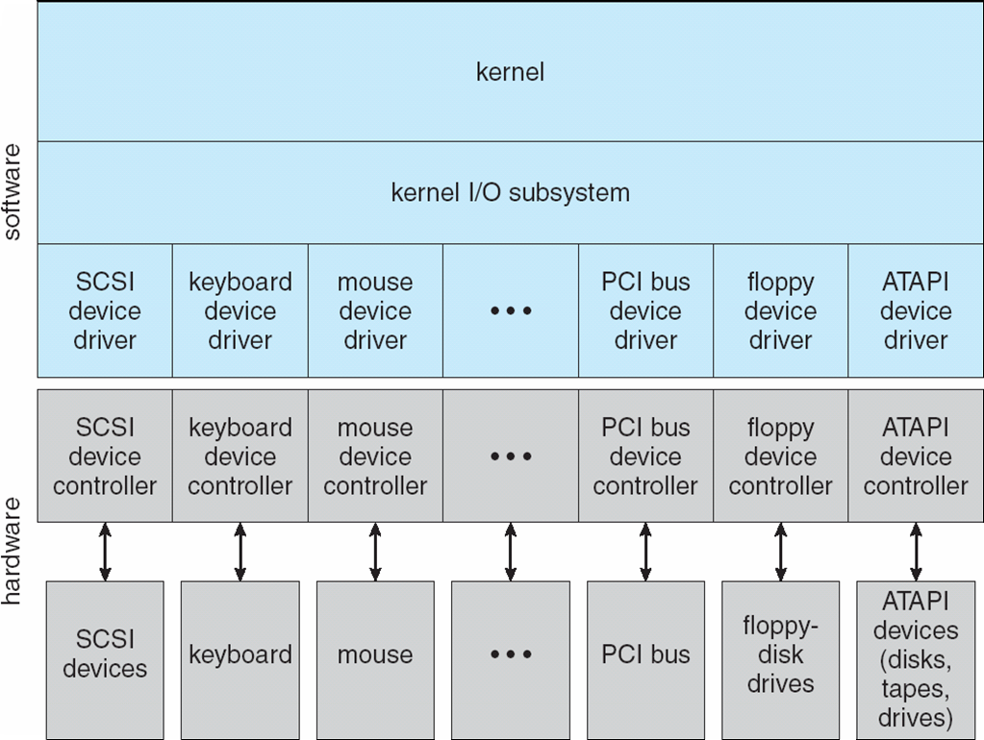
13.3 Application I/O Interface
I/O system calls encapsulate device behaviors in generic classes.
Device-driver layer hides differences among I/O controllers from kernel.
Each OS has its own I/O subsystem structures and device driver frameworks.
Devices vary in many dimensions:
Character-stream or block
Sequential or random-access
Synchronous or asynchronous
Sharable or dedicated
Speed of operation
read-write, read only, or write only
24

Slide 25
Characteristics of I/O Devices
aspect
variation
example
data-transfer mode
character
block
terminal
disk
access method
sequential
random
modem
CD-ROM
transfer schedule
synchronous
asynchronous
tape
keyboard
sharing
dedicated
sharable
tape
keyboard
device speed
latency
seek time
transfer rate
delay between operations
I/O direction
read only
write only
read-write
CD-ROM
graphics controller
disk
25

Slide 26
Characteristics of I/O Devices
Subtleties of devices handled by device drivers.
Broadly I/O devices can be grouped by the OS into
Block I/O
Character- stream I/O
Memory-mapped file access
Network sockets
OS provide special system calls to access a few additional devices, such as time-of-day clock and a timer.
OSs have an escape / back door, transparently passes arbitrary commands from an application to a device driver.
Unix ioctl() call to send arbitrary bits to a device control register and data to device data register.
26

Slide 27
Block and Character Devices
Block devices include disk drives.
Commands include read(), write(), seek()
Raw I/O, direct I/O, or file-system access
Memory-mapped file access possible
File mapped to virtual memory and clusters brought via demand paging
DMA
Character devices include keyboards, mice, serial ports
Commands include get(), put()
Libraries layered on top allow line editing
27

Slide 28
Network Devices
Varying enough from block and character to have own interface.
The socket interface, Linux, Unix and Windows
Separates network protocol from network operation
Includes select functionality: manages a set of sockets
The system calls in the socket interface enable an application
to create a socket
to connect a local socket to a remote address
to listen for any remote application to plug into the local socket
to send and receive packets over the connection
Approaches vary widely (pipes, FIFOs, streams, queues, mailboxes)
28

Slide 29
Clocks and Timers
Provide current time, elapsed time, timer
Programmable interval timer used for timings, periodic interrupts.
Normal resolution about 1/60 second.
Some systems provide higher-resolution timers.
ioctl (on UNIX) covers odd aspects of I/O such as clocks and timers.
29

Slide 30
Blocking I/O and Nonblocking I/O
Blocking - process suspended until I/O completed
Easy to use and understand
Insufficient for some needs
Nonblocking - I/O call returns as much as available
E.g. User interface, receives keyboard and mouse input while processing and displaying data on the screen. Video application, reads frames from a file on disk while simultaneously decompressing and displaying the output on the display.
Overlap; Implemented via multi-threading.
Returns quickly with count of bytes read or written.
select() to find if data ready then read() or write() to transfer.
Asynchronous - process runs while I/O executes
Difficult to use
I/O subsystem signals process when I/O completed.
30

Slide 31
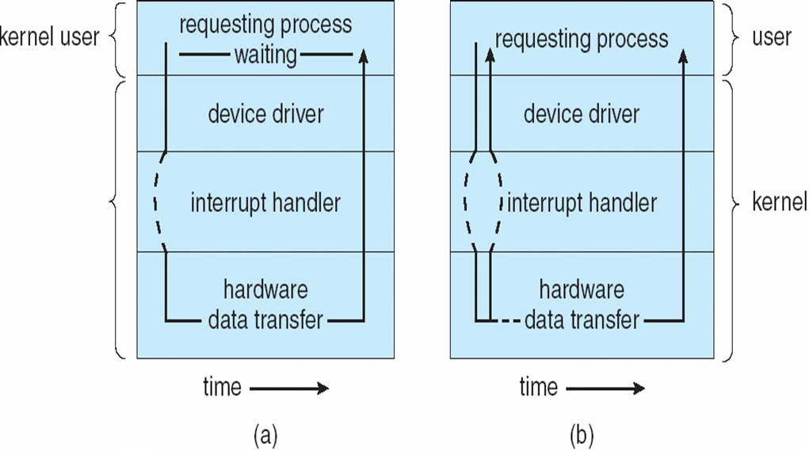
Two I/O Methods
Synchronous
Asynchronous
31

Slide 32
13.4 Kernel I/O Subsystem
Services provided by kernel I/O subsystem:
① Scheduling
② Buffering
③ Caching
④ Spooling
⑤ device reservation
⑥ error handling
⑦ I/O Protection
32

Slide 33
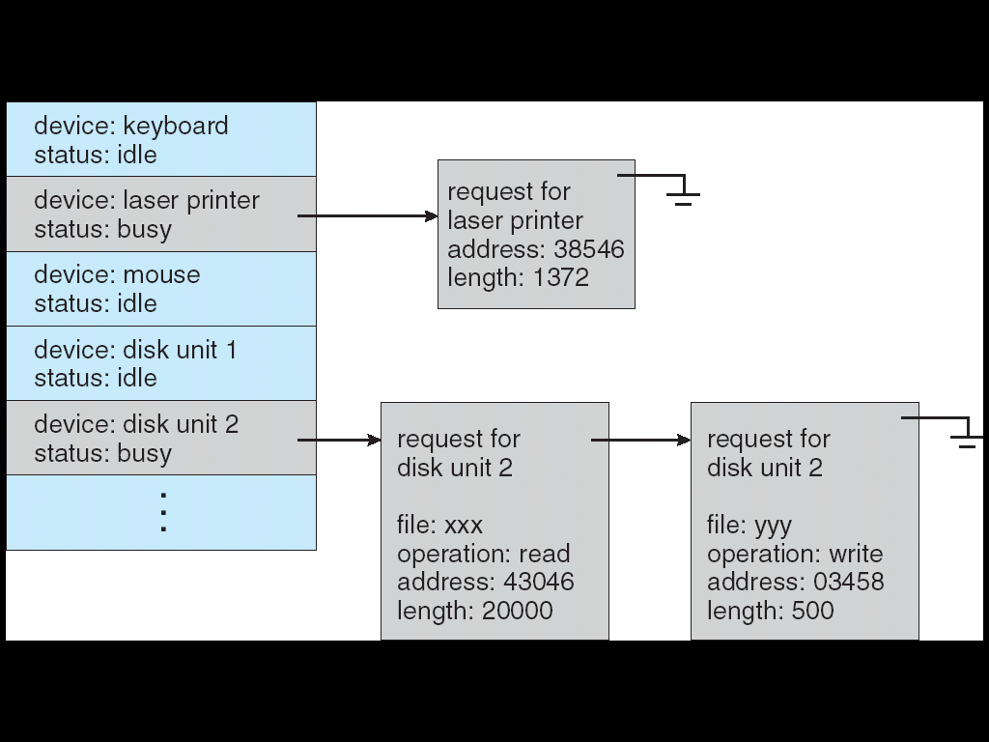
① I/O Scheduling
Some I/O request ordering via per-device queue
Some OSs try fairness
Priority?
FCFS
SSTF
SCAN
C-SCAN
LOOK
C-LOOK
33

Slide 34
② buffering
Buffering - store data in memory while transferring between devices
To cope with device speed mismatch e.g. a file is being received via modem for storage on the hard disk.
To cope with device transfer size mismatch e.g. fragmentation and reassembly of message.
To maintain “copy semantics” e.g. an application write a buffer of data to disk.
I/O buffering
block-oriented, stream-oriented
single buffer, double buffer, circular buffer
34

Slide 35
I/O Buffering
Block-oriented
Information is stored in fixed sized blocks.
Transfers are made a block at a time.
Used for disks and tapes.
User process can process one block of data while next block is read in.
Swapping can occur since input is taking place in system memory, not user memory
Operating system keeps track of assignment of system buffers to user processes.
Stream-oriented
Transfer information as a stream of bytes.
Used a line at time.
Used for terminals, printers, communication ports, mouse, and most other devices that are not secondary storage.
User input from a terminal is one line at a time with carriage return signaling the end of the line.
Output to the terminal is one line at a time.

Slide 36
Single Buffer
Operating system assigns a buffer in main memory for an I/O request.
Block-oriented
Input transfers made to buffer
Block moved to user space when needed
Another block is moved into the buffer
Read ahead
Operating system
User process
In
move
I/O device

Slide 37
Double Buffer
Operating system
User process
In
move
I/O device
Use two system buffers instead of one
A process can transfer data to or from one buffer while the operating system empties or fills the other buffer

Slide 38
Circular Buffer
Operating system
User process
In
move
I/O device
…
More than two buffers are used
Each individual buffer is one unit in a circular buffer
Used when I/O operation must keep up with process

Slide 39
③ caching
Caching - fast memory holding copy of data.
Key to performance.
Always just a copy.
difference between a buffer and a cache
A buffer may hold the only existing copy of a data item.
A cache just holds a copy on faster storage of an item that resides elsewhere.
Sometimes, a region of memory can be used for both purposes.
First level cache / cache on chip：16KB，32KB
Secondary cache：128KB，256KB，512KB
Third level cache
80%
80%
39

Slide 40
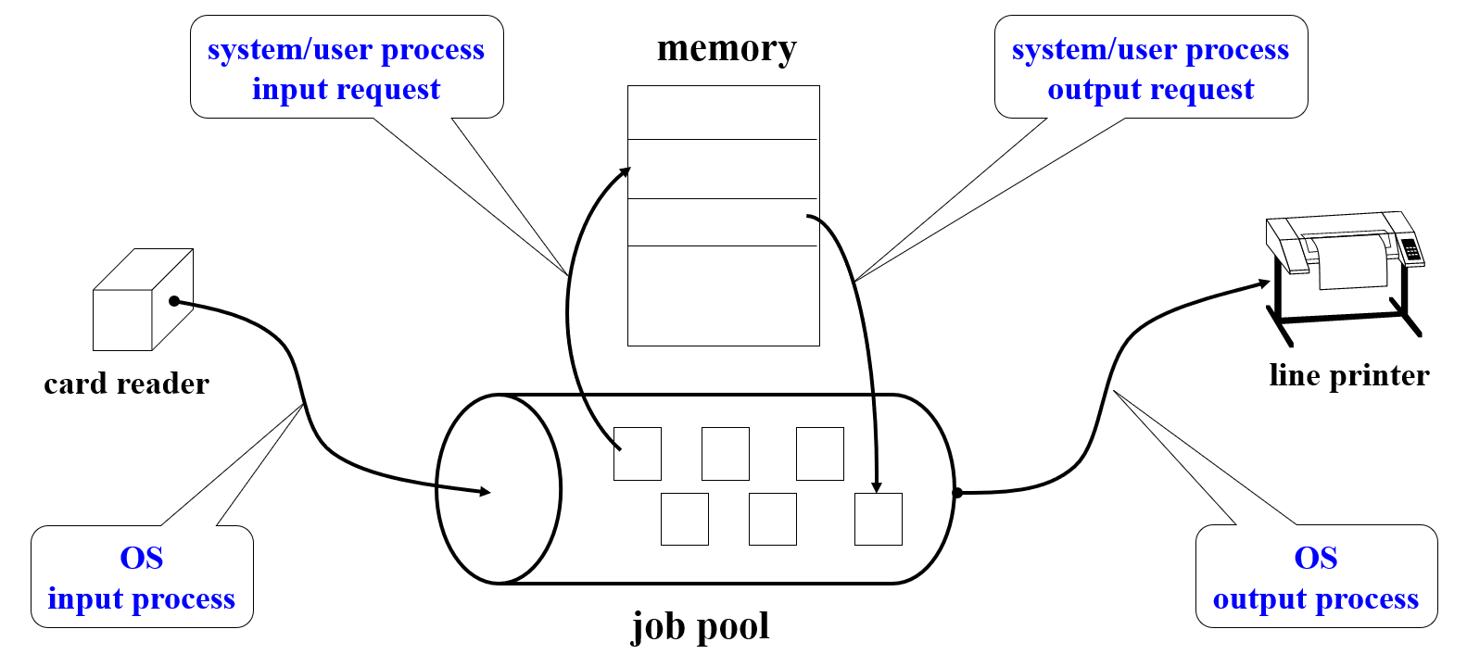
④ Spooling
Spooling - hold output for a device
If device can serve only one request at a time, i.e., Printing
Each application's output is spooled to a separate disk file.
The spooling system copies the queued spool files to the printer one at a time.
40

Slide 41
⑤ Device reservation
Device reservation(预约) - provides exclusive access to a device
System calls for allocation and deallocation
Watch out for deadlock
41

Slide 42
⑥ Error Handling
OS can recover from disk read, device unavailable, transient write failures.
Retry a read or write, for example
Some systems more advanced – Solaris FMA, AIX
Track error frequencies
stop using device with increasing frequency of retry-able errors
Most return an error number or code when I/O request fails. (about 100, indicates the general reasons for failure.)
System error logs hold problem reports
42

Slide 43
⑦ I/O Protection
User process may accidentally or purposefully attempt to disrupt normal operation via illegal I/O instructions.
All I/O instructions defined to be privileged.
I/O must be performed via system calls.
Memory-mapped and I/O port memory locations must be protected too.
43

Slide 44
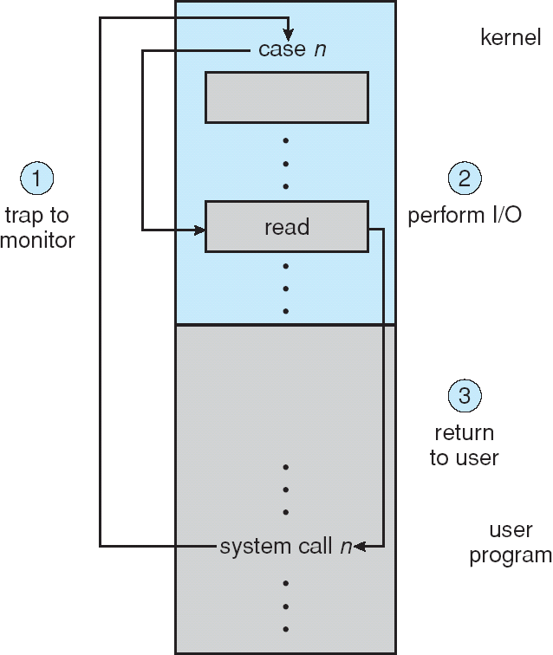
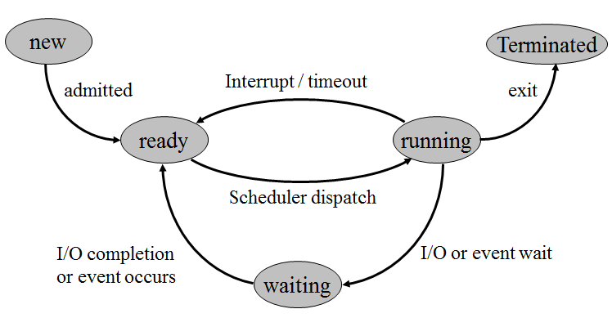
Use of a System Call to Perform I/O
44

Slide 45
Kernel Data Structures
Kernel keeps state information for I/O components, including open file tables, network connections, character device state.
Many complex data structures to track buffers, memory allocation, “dirty” blocks.
Some use object-oriented methods and message passing to implement I/O.
Message with I/O information passed from user mode into kernel.
Message modified as it flows through to device driver and back to process.
compared to shared data structures，Pros / cons?（利弊？）
Simplify the structure and design of the IO subsystem, and increase flexibility.
Increase overhead.
45

Slide 46
UNIX I/O Kernel Structure
46

Slide 47
Kernel I/O Subsystem Summary
I/O subsystem supervises these procedures
Management of the name space for files and devices
Access control to files and devices
Operation control (for example. a modem cannot seek ())
File-system space allocation
Device allocation
Buffering, caching, and spooling
I/O scheduling
Device-status monitoring, error handling, and failure recovery
Device-driver configuration and initialization
The upper levels of the I/O subsystem access devices via the uniform interface provided by the device drivers

Slide 48
13.5 Transforming I/O Requests to Hardware Operations
Consider reading a file from disk for a process:
Determine device holding file
Translate name to device representation
Physically read data from disk into buffer
Make data available to requesting process
Return control to process
open(filename, …)
Layered File System
system open-file table
file-id
process open-file table
read(fp, …)
48

Slide 49
Life Cycle of An I/O Request
Request I/O
user process
I/O completed, input data
available, or output completed
system call
return from system call
Can already
satisfy request?
kernel I/O subsystem
Transfer data (if appropriate)
to process, return completion or error code
Yes
No
Send request to device driver,
block process if appropriate
kernel I/O subsystem
Determine which I/O completed,
indicate state change to
I/O subsystem
process request, issue commands to controller, configure controller，
to block until interrupted
device driver
Receive interrupt, store data in
device-driver buffer if input,
signal to unblock device driver
interrupt handler
device controller commands
interrupt
Monitor device, interrupt
when I/O completed
device controller
I/O completed, generate interrupt
49

Slide 50
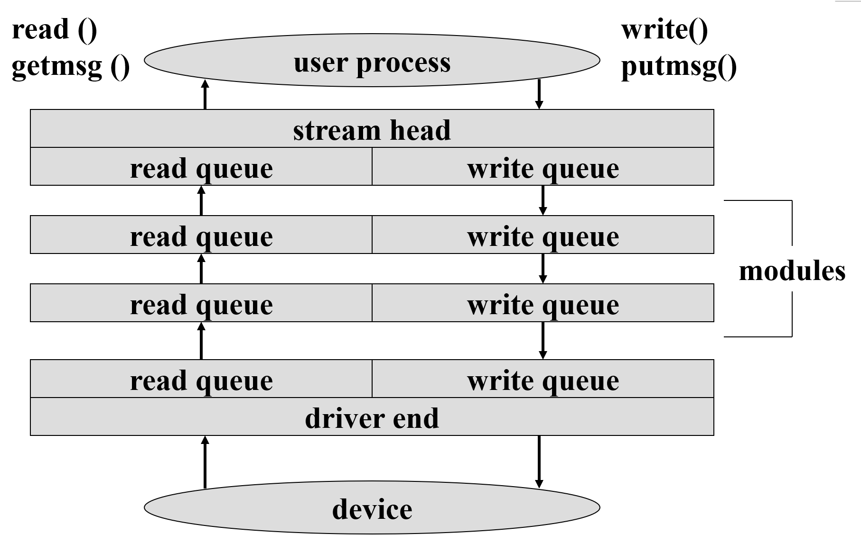
13.6 STREAMS
STREAM – a full-duplex communication channel between a user-level process and a device in Unix System V and beyond.
STREAM structure:
Message passing is used to communicate between queues.
Flow control option to indicate available or busy.
Asynchronous internally, synchronous where user process communicates with stream head.
50

Slide 51
13.7 Performance
I/O is a major factor in system performance:
Demands CPU to execute device driver, kernel I/O code
Context switches due to interrupts
Data copying
Network traffic especially stressful
device
Device
controller
Kernel
buffer
process
Memory space
51

Slide 52
Intercomputer Communications
character
typed
system call
completes
network
packet
received
hard-
ware
context
switch
hard-
ware
interrupt
generated
interrupt
handled
network
adapter
state
save
state
save
interrupt
generated
interrupt
handled
interrupt
generated
network
state
save
device
driver
network
adapter
device
driver
kernel
network
subdaemon
device
driver
kernel
context
switch
context
switch
context
switch
user
process
context
switch
kernel
context
switch
network
daemon
kernel
sending system
receiving system
52

Slide 53
Improving Performance
Reduce number of context switches
Reduce data copying
Reduce interrupts by using large transfers, smart controllers, polling
Use DMA
Use smarter hardware devices
Balance CPU, memory, bus, and I/O performance for highest throughput.
Move user-mode processes / daemons to kernel threads.
53

Slide 54
Device-Functionality Progression
new algorithm
increased time (generations)
increased efficiency
increased development cost
increased abstraction
application code
Increased flexibility
kernel code
device-driver code
device-controller code (hardware)
device code (hardware)
54

Slide 55

课后作业及研究性学习
作业
掌握I/O技术
掌握I/O请求的处理过程
研究性学习
分析比较使用数组/链表实现队列/堆栈的方法
55

